Slide 1

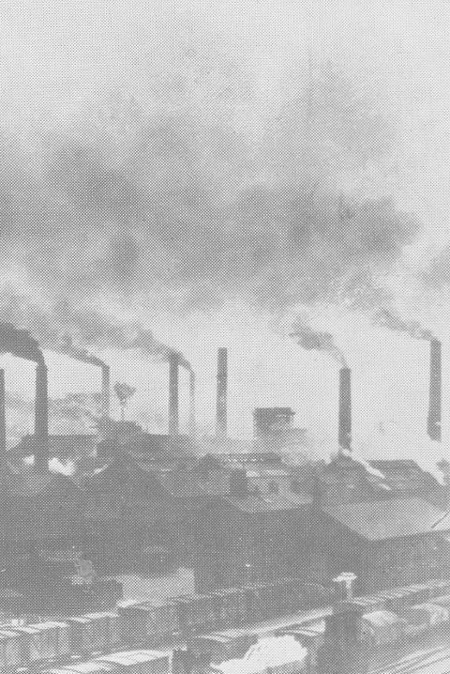
The Urban Game
An exercise in urbanization and industrialization

Slide 2

Let’s Begin!
You live in a rural village
Your village should contain the following items at this point:
  A river that runs from one end of the map to the opposite end (your river should not be more than 3 squares wide)
  Two roads (1 square wide) that intersect near the middle of your map and extend off the map in each cardinal direction.
  10 houses
  1 church
  1 cemetery
  1 store
  1 pub
  1 coal mine
  1 park
  And of course, you need to give your village a name!

Slide 3
Background on Your Village
  Life here in our rural village is similar to other villages throughout the land. Change traditionally comes very slowly. People moved at a much slower pace and had access to very little information about the world outside their village.
  The Three out of every four Englishmen were rural and lived in small villages like this one. The average village was inhabited by about 200-400 people. The tallest structure in the village was the church. The religion of England is Anglican (Church of England).
  Home life & work life were closely integrated as most work was done in nearby fields or in the home or perhaps adjoining workshop. The family was an economical unit as well as a social unit. Every member of the family worked very hard from sun-up to sun-down. Even small children had chores.

Slide 4
Background on Your Village
  The homes of villagers were very small with earthen floors and inadequate lighting and ventilation. All members of the family slept in the same room and sometimes shared living quarters with the livestock. Sons worked with their fathers farming and tending livestock while daughters worked with their mothers cleaning, cooking, sewing and at other domestic chores.
  Life expectancy was slightly over 40 years of age. Most people married in their teens and had babies before they were 20. It was common for women to die during childbirth so the average marriage lasted about 15 years. Step mothers and step fathers were common. One baby out of three died before their first birthday, only one child in two saw their 21st birthday.

Slide 5
Background on Your Village
  Unlike France, the English were not rigidly divided into social/legal Estates. However, there was a distinct social class system. Most English were poor farmers. A few were middle class like the bourgeoisie of France. They lived, for the most part, in London. Still a small few were aristocrats and usually owned large tracts of land in the English countryside.
  For both peasant & aristocrats, the soil was the key to the economy. Land was the source of livelihood and well-being. Having enough land to produce adequate food, or to produce enough to sell, or even to rent was the key to economic survival.

Slide 6
Background on Your Village
  The main occupation of England was farming. Private and public lands were not separated by fences as they are today. Every village had a public area called “the commons”. This was land which was available to anyone for pasturing, hunting, the gathering of firewood, growing of crops, etc... So poor farmers who did not own their own land, or rented, could eke out a marginal living by depending on the commons. Unlike France, most English peasants or farmers did own their own land, however small.
  Fence off a 10x10 area to be reserved as a commons.

Slide 7
Background on Your Village
  Villages were connected by a system of dirt roads that became almost impassable during the wet season. As a result, transportation was often slow and trade beyond the village was not easy. Most English farmers never visited any place further than 25 miles from their birthplace, ever! People made their own food, clothes, furniture, tools, and homes. A few items which could not be produced could be obtained from wondering peddlers.
  Finally for fuel, there were two sources: firewood & coal. Nearly every English village had a coal mining operation. These mines employed a small number of village dwellers, especially in the winter. Coal pits from which coal was extracted belonged to the owner of the property where the coal mine was situated.

Slide 8
Background on Your Village
  Over the next 100 years, the industrial revolution will completely change life in your village. Some historians believe this revolution is the most fundamental change in human history. We will experience some of these changes during the game.

Slide 9
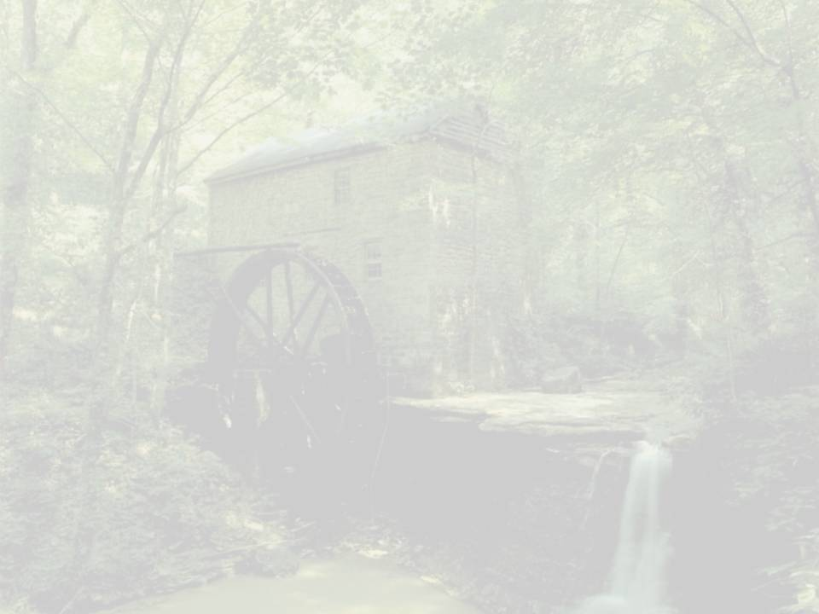
Round 1
It is now 1745. England’s geography is unique in that no section of the country is more than 90 miles from the sea and there are many navigable rivers that crisscross the countryside. An enterprising young capitalist (you) decides to invest money in the construction of a canal.
This is not a public venture but rather a private one. The profits from your canal are astonishing! For example, one canal built in 1745; the Oxford Canal yielded a 300% annual return for its investors for a period of more than 30 years. This new revolution in transportation reduced the price of raw materials and reduced the cost of transportation drastically. Coal could now be transported from the mines to the towns for half the price of horse-wagon transportation.
Construct a canal (a waterway 1 square wide that runs nearby the river and connects to the coal mine.)
Since you invested your money, thereby making a tidy profit, build yourself 1 nice home anywhere on the map you would like it to be.

Slide 10
Round 2
It is now 1750. For a variety of different reasons (soap, diet, sanitation, etc…) there is a population explosion in England, and your village. The cursed Bubonic Plague which for centuries wiped out your village has been virtually eliminated due to the disposal of sewage into the canals and ultimately the ocean.
Add 5 houses (total 15).

Slide 11
Round 3
It is 1760. The people of your village need a bit more food and goods to meet the needs of the new inhabitants. Coincidentally, a number of other noteworthy events occur around 1760. First, a number of new mechanical inventions for farming are developed. Perhaps the greatest impact was Jethro Tull’s creation of the seed drill and the horse drawn cultivator. Also, farmers begin to experiment with new, more productive farming practices like crop-rotation, new fertilizers, & new livestock breeding techniques.
Consequently farm production is significantly increased. But there is one problem. Most farmers own one tract of land. Why should they, or how could they, invest in expensive machines when their land is so small? What’s more, it’s almost impossible to buy land from anyone! At the same time, pressure is placed on Parliament by large and small landowning farmers to make more land available. Where is that land coming from? The Commons of course! A series of laws call the Enclosure Acts are passed by Parliament. This means that landowners can buy pieces of common land from the government.
You may from this point forward build on the commons.
Add 5 houses (total 20) and 1 more nice house (on what used to be the commons).

Slide 12
Round 4
It is now 1773. A man named Richard Arkwright invents a new machine that can spin and weave cloth a hundred times faster than could be done by hand in a farm cottage ( the most common way of producing cotton cloth up to this time; the cottage industry (putting-out system). He calls his new machine the Water Frame because its principle source of power was water. Let’s imagine that the first water frame was built in your village (because of the river). Since the water frame was large, a special building was needed and thus, the first factory for producing cotton cloth was built.
Add 1 factory
  Remember, the cotton factory must be placed on the river bank. Canal water is not swift enough to generate the power to the working parts of the water frame.
Add 5 houses for workers (total 25)

Slide 13
Round 5
It is now 1774. Workers are needed to work in this new factory. Since many people (women) cannot compete with the spinning and weaving of cloth made in the factory and there are large numbers of poor families who have lost their livelihood due to the Enclosure Acts, we do have an available supply of workers. People move to your village to find work.
Add 15 houses (total 40);
1 church
1 pub
1 store
You may draw additional roads and 1 additional bridge.

Slide 14
Round 6
The profits from the first textile factory are enormous. It should be no surprise that Richard Arkwright is referred to with two titles: The first millionaire and the father of the factory. New factories are built in your community:
The early owners of these factories called themselves capitalists because they had the capital or money to purchase the raw material, the building, the water frame, and to pay their workers a fixed wage and make a profit.
Add 5 new factories (must be on the river bank as they need water power).
Add 15 houses (total 55)

Slide 15
Round 7
It is 1780. Unemployed workers from surrounding areas flood into your community looking for work. Although wages are very low, they look attractive to starving families. Housing is in great demand and for the first time a new kind of housing is constructed called Tenements. Here dozens of families reside under one roof. All workers walk to work, so the tenements must be near the factories.
Add 5 Tenements (within five squares of a factory).

Slide 16
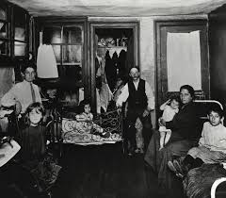
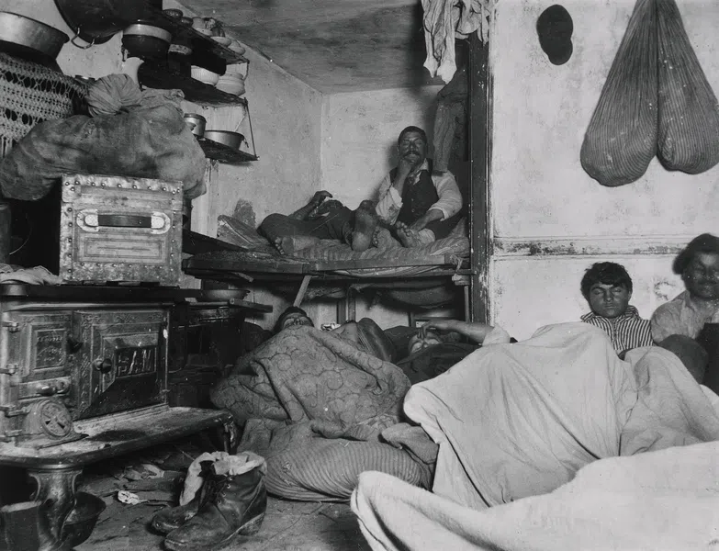
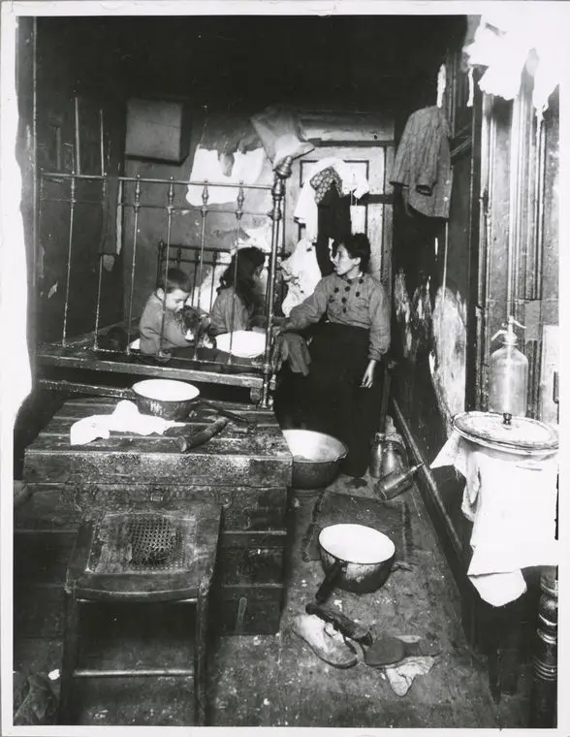
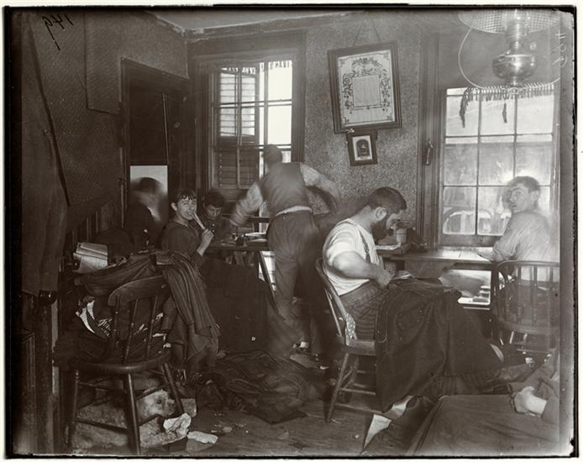
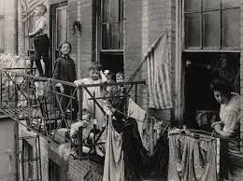

Slide 17
Round 8
It is now 1781. More workers need to live, eat, shop, drink, worship. We need the social support services to go along with the demand.
Add 1 store
1 pub
1 school for those families wealthy enough to send their children (boys) to school.
1 church
  Since workers in the factories work 6 days a week, the only day of rest is Sunday. People flock to your churches so make them convenient for their tired feet.

Slide 18
Round 9
It is now 1782. Workers work long, hard hours in the factories. The average work day begins at 6:00 a.m. and ends at 9:00 p.m. There is only a 30 minute break for lunch. After work, exhausted, “stressed out” workers stop at their local pub for some relaxation. Alcohol begins to be consumed throughout England in record amounts.
Add 5 more pubs
Destroy 5 houses
Add a jail
Add 4 tenements

Slide 19
Round 10
It is now 1783. Workers barely eke out a marginal existence. There is never enough money to save and some workers go into debt. Few, if any, could afford to send their children to school. Still, there are a few families whose lifestyle is quite comfortable, even luxurious. Who are they? They are the large landowning farmers and factory owners.
Add 2 nice homes.
Handsome manor houses are built and some are lavishly furnished with art. These new rich (nouveau riche) are not part of the aristocratic class of England but they now can enjoy some of the refinements of the aristocratic rich such as food, servants, furniture, education, fine clothing, carriages, etc….
Add 1 factory
Add 15 houses for management personages

Slide 20
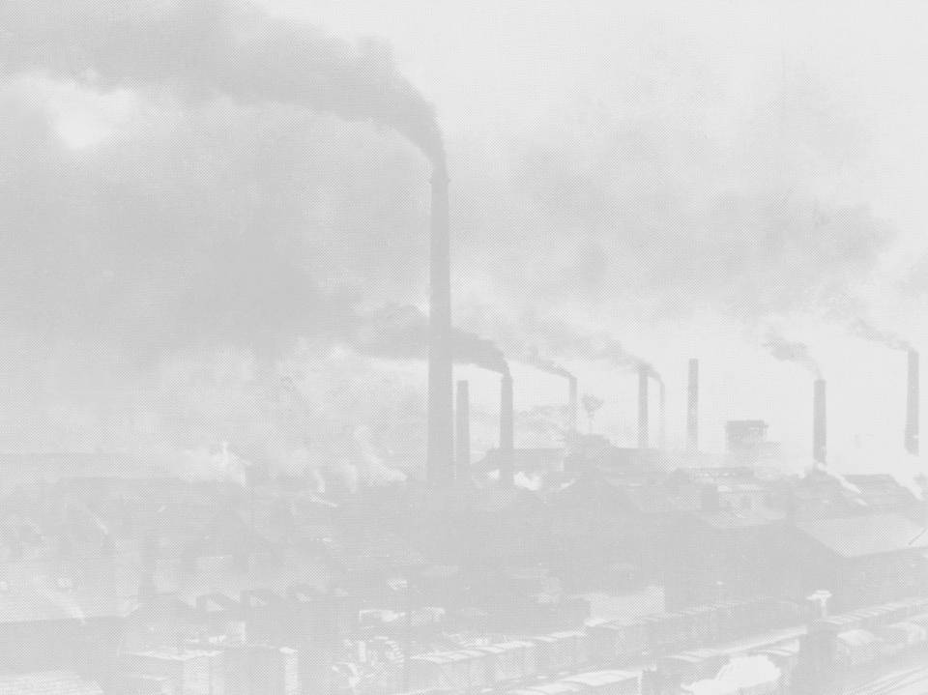
Round 11
The year is 1785. A man named James Watt invents a new machine called the steam engine. The steam engine replaces the water frame. First, it is far more efficient. Second, it allows factories to be built away from the river. This source of power is more mobile. Capitalists quickly replace their water frames with steam powered weaving and spinning machines. The main business in England is still textile manufacturing.
Add 10 factories with smoke (total 17)
  Smoke should be a 4x4 square of light shading over each factory. Add smoke to all other pre-existing factories.
Add one nice house since people continue to get rich.
Add 5 houses (total 70)
1 tenement.

Slide 21
Round 12
The year is 1800. A man named Henry Cort has just invented the puddling process. This process makes it possible for coal, which is, fortunately, in abundant supply in England, to be used as the primary fuel in the new iron industry. Consequently, your town is thrust into the “New Age of Heavy Industry”. Larger factory districts appear which manufacture iron at low prices and that can easily be transported by your canal.
Add 1 new coal mine
Add 1 new iron bridge to replace the old wooden one
Add 5 houses (total 75)

Slide 22
Round 13
The year is 1815. Coal miners are busy mining coal. There is a great demand for coal right now: home-heating, fuel for the steam engines, for the production of iron.
Add another coal mine
Although in the 1700’s coal miners were adults who worked in the winter to supplement their wages, in the 1800’s they are typically children between the ages of 8 and 14. The work is dangerous and unhealthy. Children become victims of black lung, explosions & accidents. Their growth is stunted as they spend their 14 hour days stooped over. They are malnourished and unable to exercise or eat properly. Casualty rates go up.
Draw 1 cemetery.

Slide 23
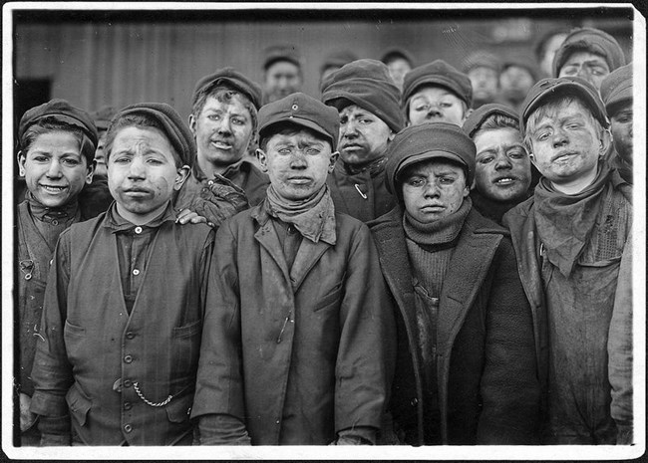
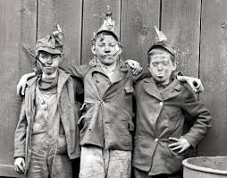
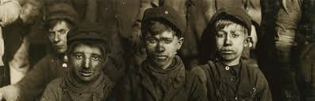
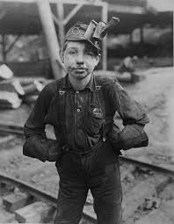
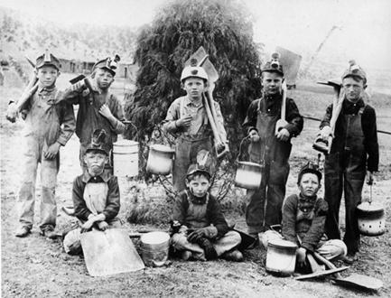
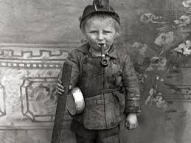

Slide 24
Round 14
It is 1820. The existing canals and dirt roads cannot accommodate the heavy industrial traffic. New experiments with transportation using the power of a steam engine are tried. The most successful appears to be a steam engine that pulls a series of wagons or cars on an iron track. The first railroad is tested and proves to be quite effective.
Add 1 major railroad line connecting all your factories to your coal mines.
  This is one continuous track which must connect all factories and mines (you may build additional railroad bridges only as needed).
Add 5 houses (total 80) for railroad builders.

Slide 25
Round 15
It is 1827. This new “revolution” in transportation draws thousands of people to your community. Soon there becomes a surplus of workers. Capitalists who wish to ensure their profits decide to hire women and children over men because can perform the same factory labor at one-half to one-quarter the price. More and more children leave their homes to work.
Depressed, ashamed, and angry about their wives and children toiling in factories, many men turn to crime, and the social life of the pub. For the first time in England’s history alcoholism appears in epidemic proportions. Family life that existed for hundreds of years in England is disrupted. Family members seldom eat together or even see each other.
Add 2 jails, 4 pubs, and 2 tenements.

Slide 26
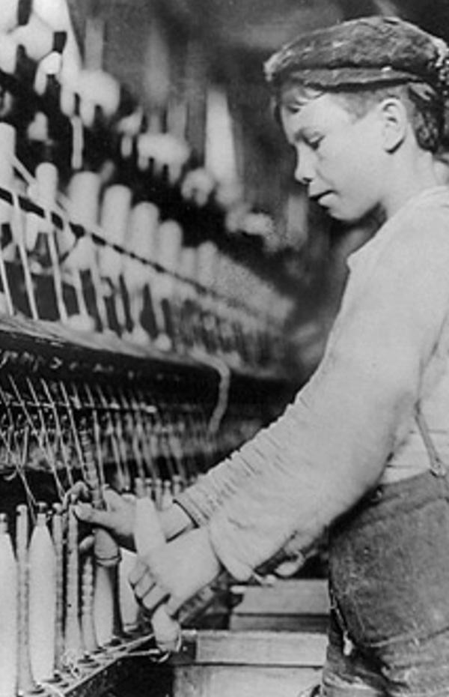
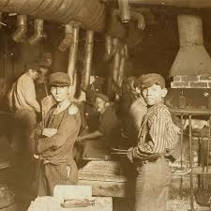
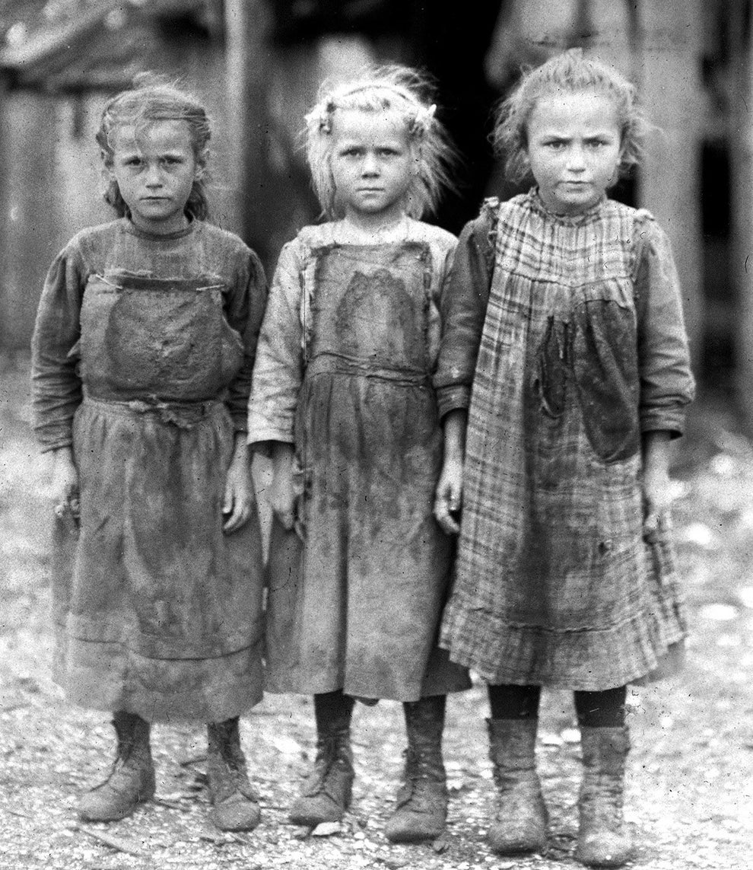
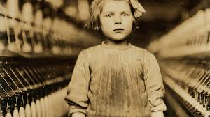
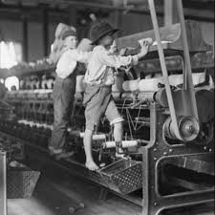
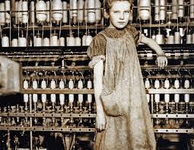

Slide 27
Round 16
It is 1838. Let’s look at the working conditions in the factories. The two predominant factories are textile and iron (steel). Working conditions in either of these two were appalling. Many workers contracted the deadly factory fever or white lung disease. It was probably a variety of lung ailments: cancer, tuberculosis, emphysema, etc… Other workers were injured on the job in factory accidents.
There were no protective railings around the huge moving mechanical parts of machinery. Children, weakened from lack of proper sleep or diet, stumbled into machinery and were mangled. Women with long hair that became undone often found themselves caught in moving machinery. Regardless, if you were unable to work, you were fired. There was no health insurance. There was always a daily line of unemployed workers waiting to fill the “vacated” jobs.
Add 2 hospitals and 1 more cemetery.

Slide 28
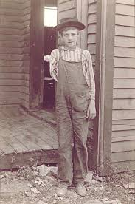
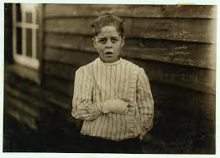
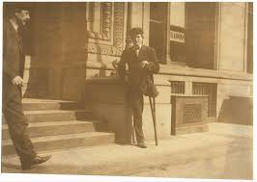
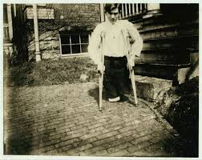
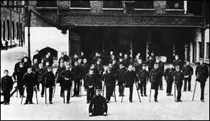
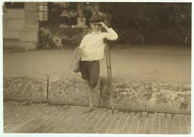

Slide 29
Round 17
It is 1840. There is a need for quicker transportation. Coal, iron, finished products, & raw materials must all be transported from one area of England to another. In Ireland in the late 1830’s a devastating potato famine drove hundreds of thousands of Irish to England. Here was the cheapest of labor possible to build more railroads.
Add 1 more railroad line passing east to west through your town.
Add 5 houses (total 85)
1 tenement for the new railroad workers.

Slide 30
Round 18
It is 1842. There are some advantages to urban dwellers. City life is very different from the country life. For the small but growing middle classes a whole new cultural life is available. Museums, theater, opera, restaurants, plays & concerts are made available. Whereas before only the aristocrats could afford the arts, now the middle class enjoys the fine life of culture and good living.
Add 1 theater and 1 museum.
Add 2 schools for upper class students
Add 1 nice house.

Slide 31
Round 19
It is 1845. There are no pollution controls so the air in your community looks dark. Windows, walls even trees are covered with layers of soot. The river that once flowed through your quiet village for hundreds of years is now unfit for drinking, bathing, or laundry. A new disease begins to take the lives of people. Malignant tumors grow in people's’ bodies and the term cancer is first used in the medical profession. The average life expectancy for the poor classes is now 30 years of age.
Your city is overcrowded and shrouded in factory smoke. The noises, the loss of privacy, & the loss of the family unit shatters the peace of the old ways. Suicide rates double, then triple.
Add 1 cemetery
1 jail
1 hospital to accommodate the victims of urban life.

Slide 32
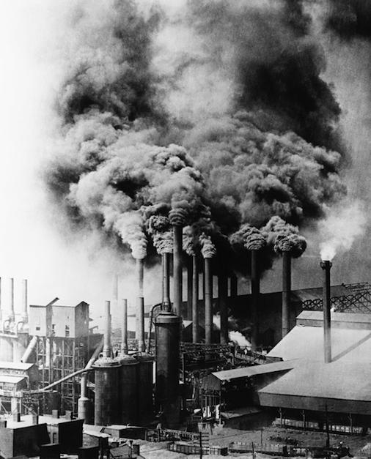
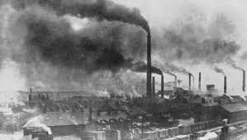
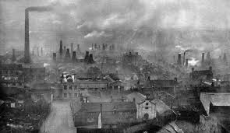

Slide 33
Round 20
It is 1850. By this year several million acres of good English land has been enclosed and sold to private parties who own large estates. Despite the misery this creates for England’s landless poor, the economic benefits for the rich are obvious. These farmers purchase the newest power-driven machinery and can easily feed the working class of England (including the Irish immigrants).
The small landowning farmer is crushed by the enclosed commons. They cannot afford the machinery and therefore cannot compete and grow food profitably. Thousands of these folk leave their villages (where their ancestors had lived for hundreds of years) and move to towns and cities looking for work to feed their families. Some refused to leave but took jobs working for the large landowning farmers. By the thousands, they moved to the bleak, uninviting towns of the north and the new cotton mills.
Add 20 houses (total 105)
5 tenements (total 18)
2 stores
1 church
5 factories
1 pub
3 more nice houses

Slide 34
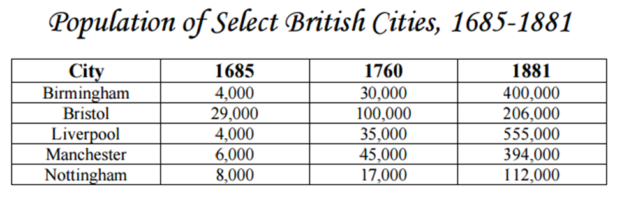
Urbanization
With the shift of work to factories, large numbers of workers moved from the countryside to the cities. This shift from rural communities to urban cities, known as urbanization, marked one of the greatest population shifts in history.

Slide 35

Questions to Consider:
What were some of the impacts that urbanization had on your village and its people over time?
What were some factors that influenced or caused these changes?
What issues do the people of your village face at the end of the game?

